Slide 1

And decentralized applications
LECTURER: ZVEZDIN BESARABOV

Slide 2
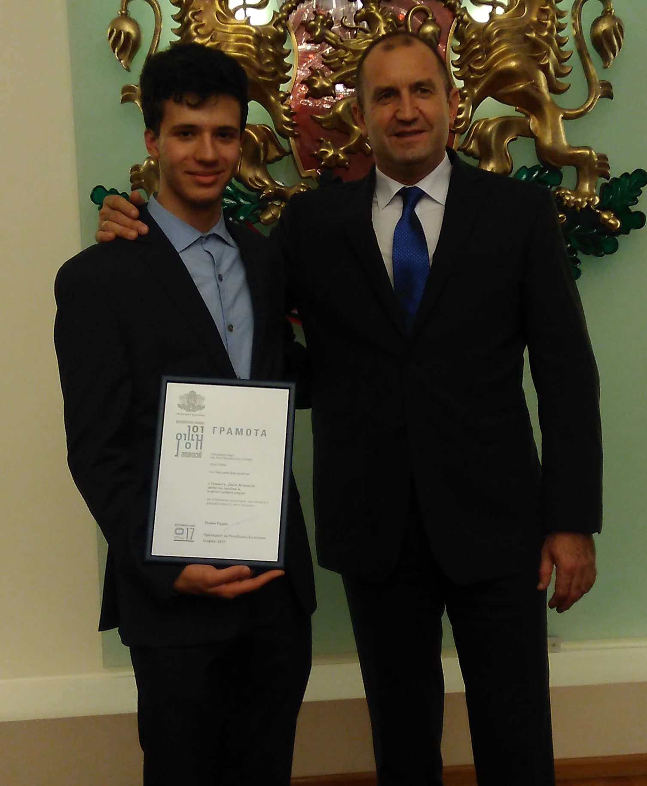
Who am I
High school student
Competitor in IT competitions
Smart contract developer

Slide 3
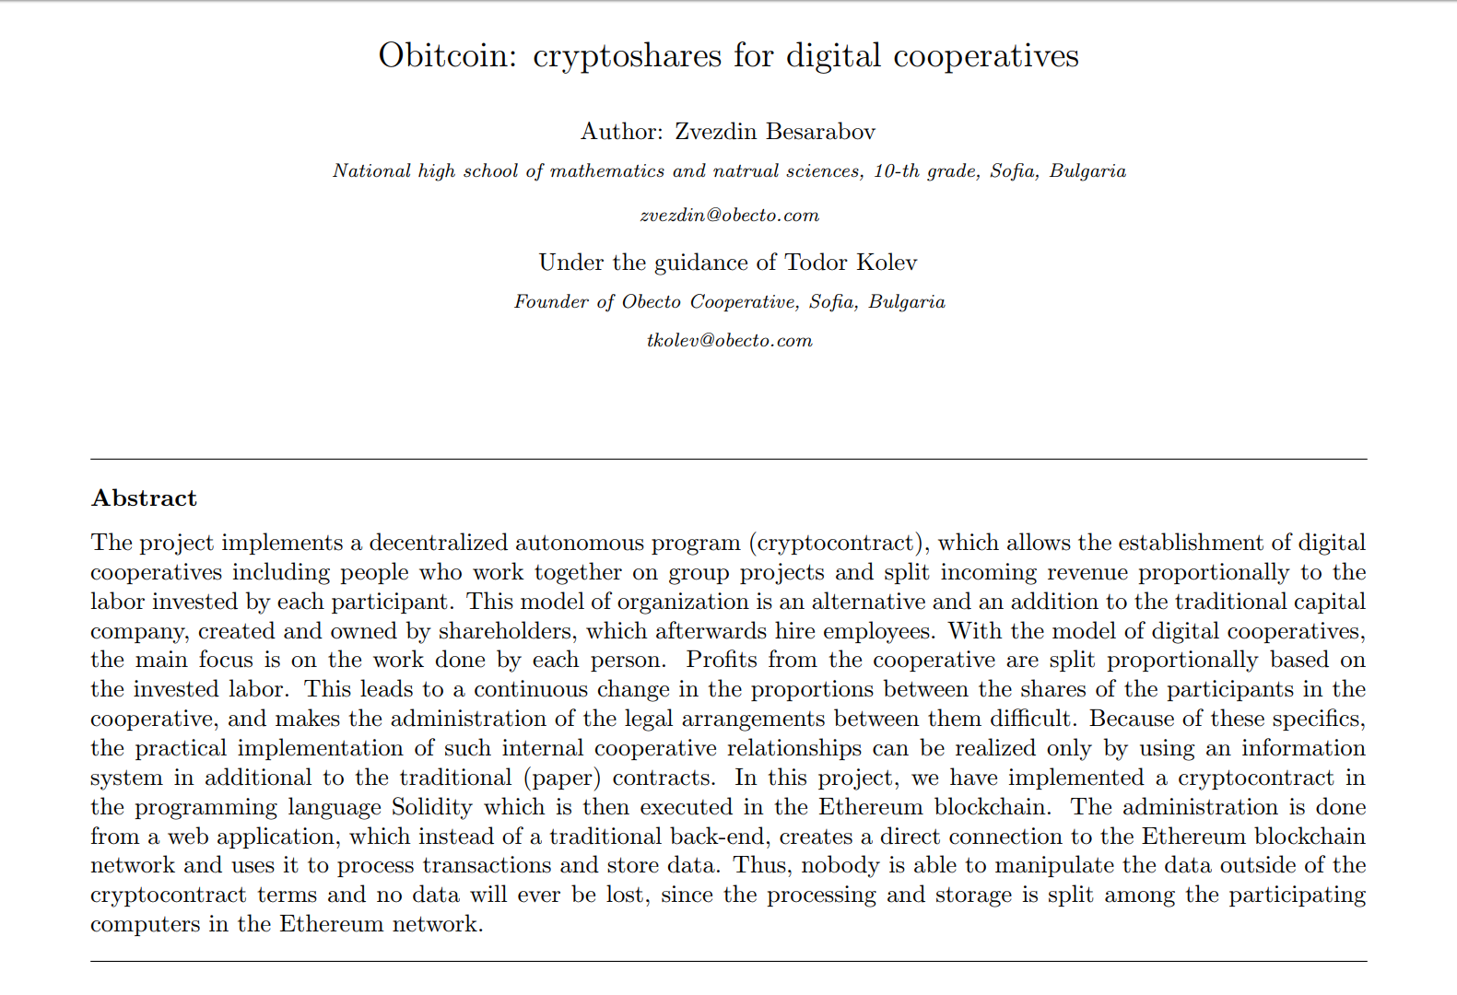

Slide 4
Plan for today
Introduction to Ethereum
Ethereum decentralized applications
Functionality, interface, key moments, pros/cons
Dangers of decentralized applications
Historical events in Ethereum
Forks, DAO / Parity hack
Useful websites
About the Solidity course

Slide 5
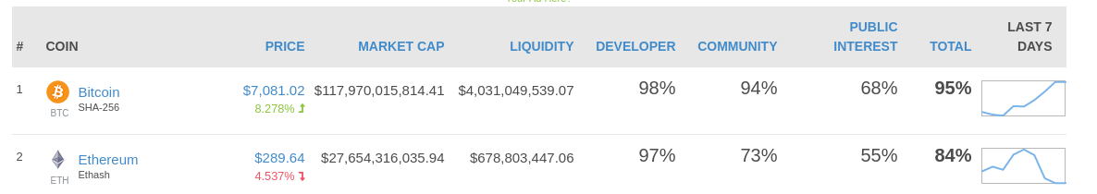
Ethereum

Slide 6
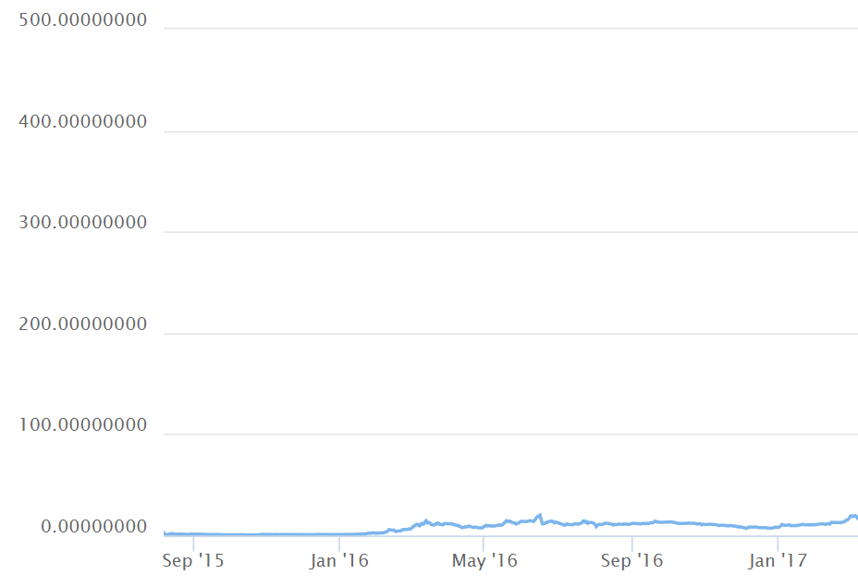
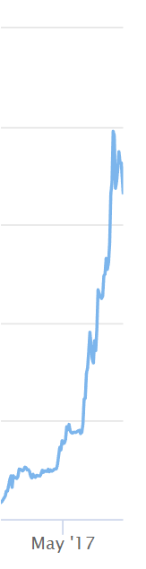
Notes:
Сега малко за Ethereum.

Slide 7
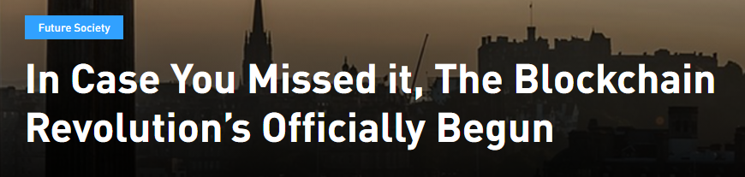
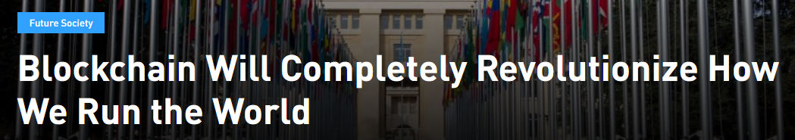
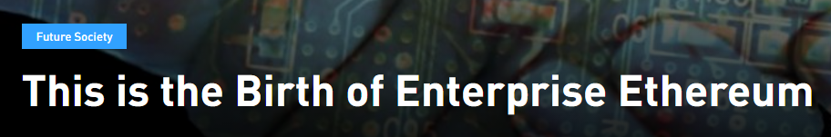

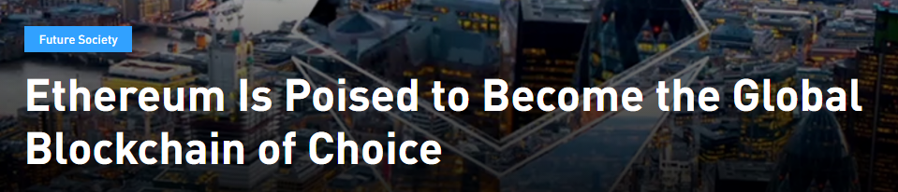
The reaction

Slide 8
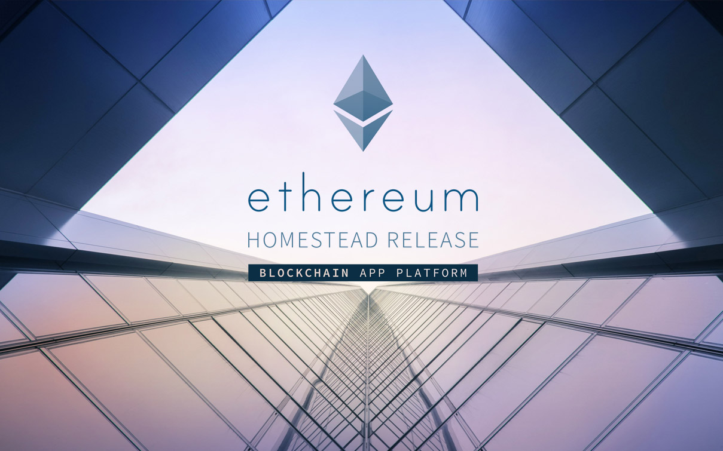
Въведение в Ehereum
Notes:
Платформа за създаване и изпълнение на блокчейн приложения, които обикновено биха изисквали чисто нов блокчейн и мрежа.

Slide 9
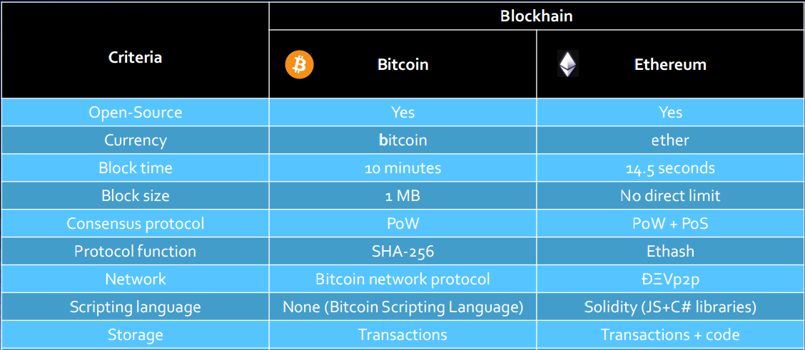
Bitcoin vs Ethereum

Slide 10
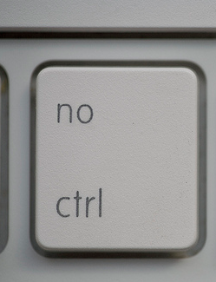
Decentralized applications (contracts)
Program on blockchain
Authonomous
Independent
No censorhsip
Like contracts
Notes:
Причината за този рязък скок са децентрализираните приложения.
Те са като сървър с 100% uptime, и никой не може да отиде и да ръгне флашката та да счупи нещата

Slide 11


Method of execution
Execution is done on an outside call
Execution is a transaction

Slide 12




Abilities
Data storage
Logic
ETH Balance
Multicontract interaction

Slide 13
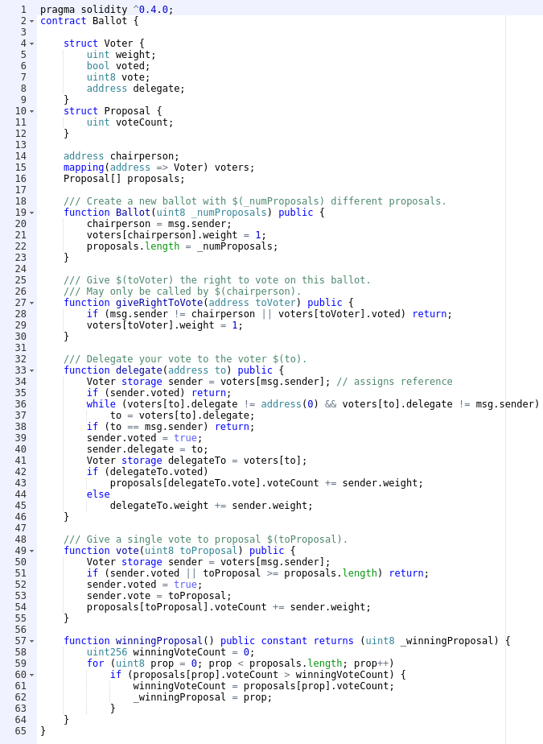

Slide 14
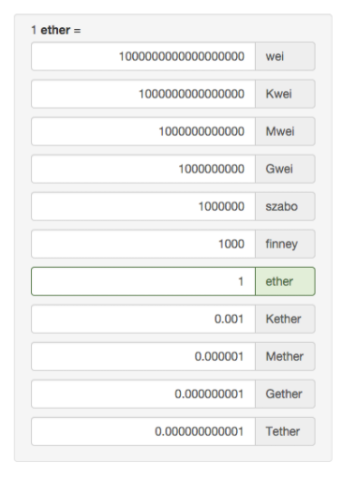
Ethereum „gas“ currency
Measurement of execution cost
1 gas = 1 operation
1 gas ~= 20 Gwei

Slide 15
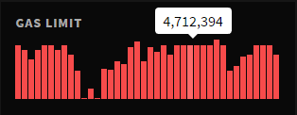
Gas limit
Maximum gas expenses for a transaction
The execution must not use more gas than the limit
Otherwise, the execution is terminated

Slide 16

Publicity
Transactions, balances, activity
Contract logic
Data
Accessibility
Prone to attacks

Slide 17

In short: pros
Blockchain guarantee
100% uptime
No censorship
Autonomy
Infinite life
Accessibility
Easy to develop *
Easy to use **
Like a law

Slide 18

In short: cons
Gas expenses
Gas limit
Publicity
Blockchain limitations
No internet access

Slide 19

Do you really need a crytpo contract?

Slide 20

Smart contract applications
Voting
Freedom of speech
Social networks
Crowdfunding
ICOs

Slide 21

Gnosis
Prediction market
Allows the users to speculate the value of products or services

Slide 22
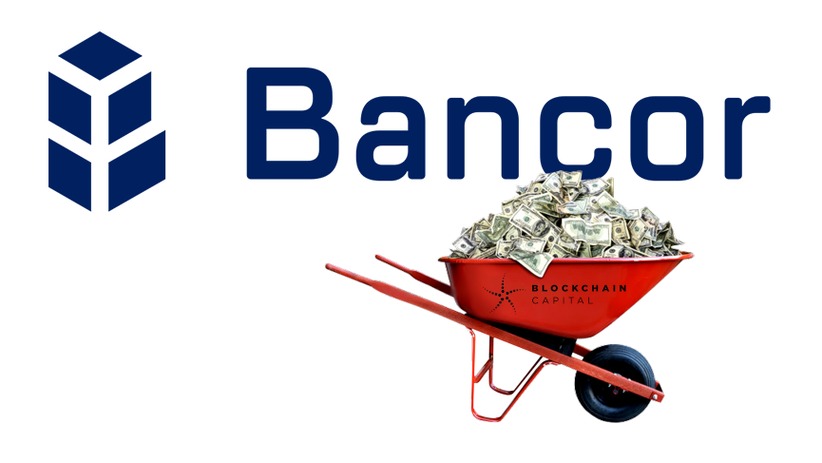
Bancor
Unify tokens, by making them “smart”
Create relationships between different tokens
Allow instant decentralized exchange between tokens

Slide 23

Obitcoin / Comrade
Framework for cooperation and creation of cooperatives
Based on consensus between members
Rewards hard work

Slide 24
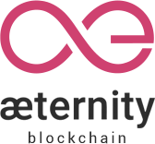
Aeternity
Side-channel communication ontop of their blockchain
Raised a lot from crowdfunding
Strong bulgarian participation
Creating an incubator

Slide 25
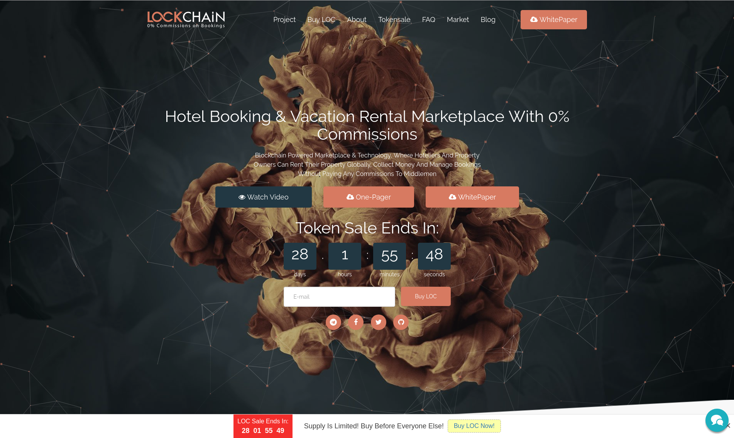

Slide 26
15 Minute break

Slide 27
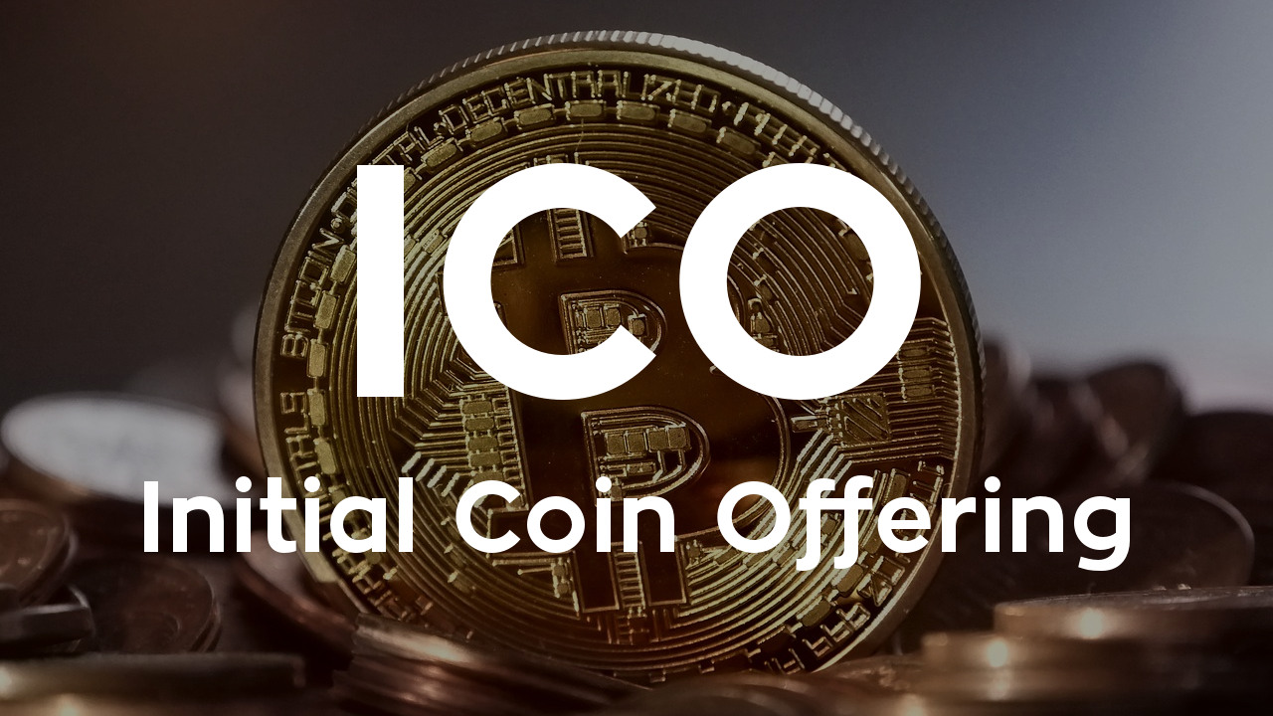
ICOs in a nutshell
Crowdfunding of projects
Public token sale

Slide 28
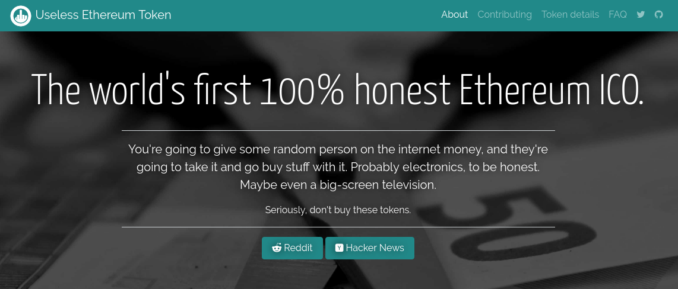
The dangers of ICOs

Slide 29
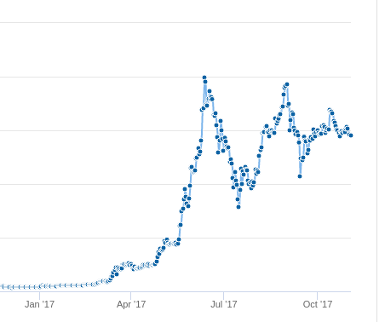
Artificial ETH Price increase
Speculative investment
Boom of ICOs
Bad for contracts
The main objective of Ethereum

Slide 30
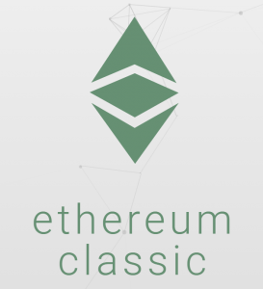
The DAO attack
June 17, 2016
Vulnerability in the DAO
Hacker drained $53M
Resulted in Hard fork
Split into Ethereum and Ethereum classic

Slide 31
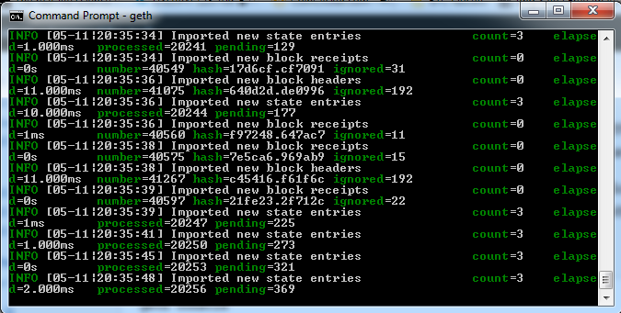
Sep 19, 2016 DOS attack
Vulnerability in GETH
Caused a global crash
During devcon2

Slide 32
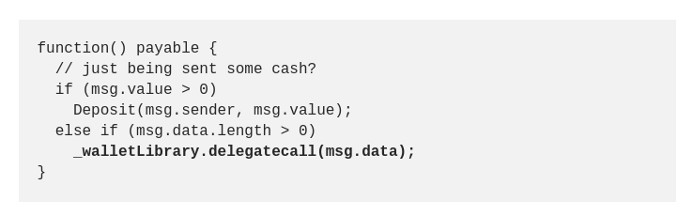
Parity Multi-sig wallet hack
Jul 19, 2017
Vulnerability in Parity’s Multi-sig wallet
150,000 ETH Stolen (~$30M at the time)
Never returned
Aeternity suffered major loss

Slide 33
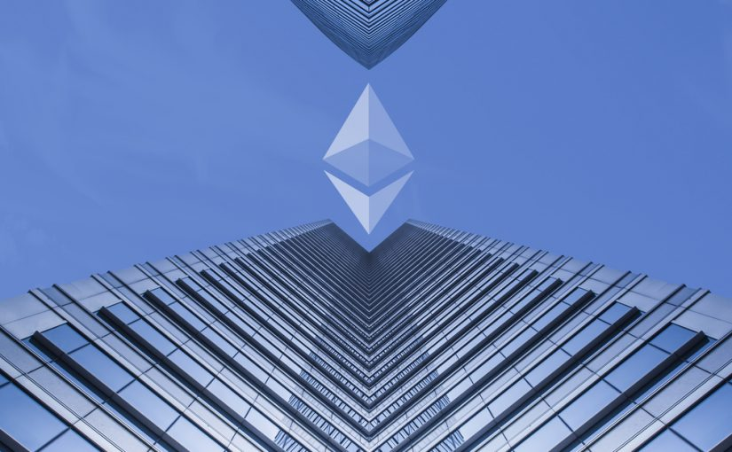
Upcoming Casper Update
Future fork
PoS consensus
Somewhere 2018
GPU Mining obsolete

Slide 34
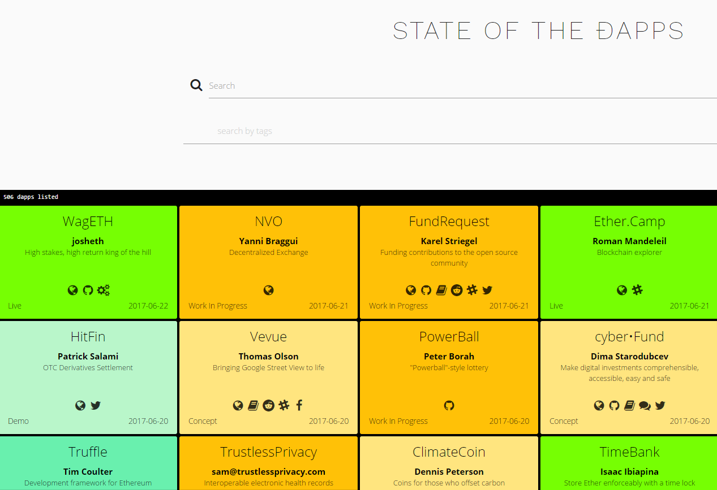
State of the Dapps
dapps.ethercasts.com

Slide 35
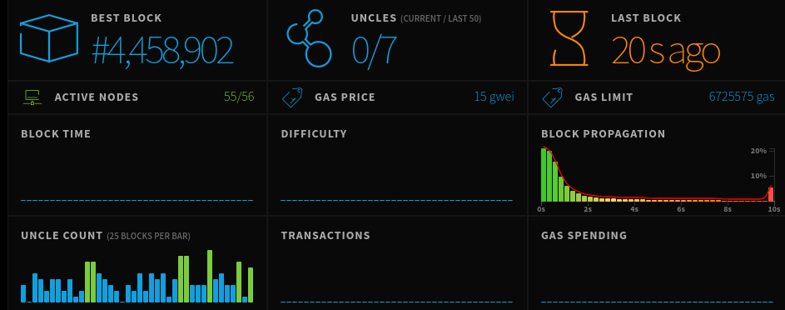
Ethereum network statistics
ethstats.net

Slide 36
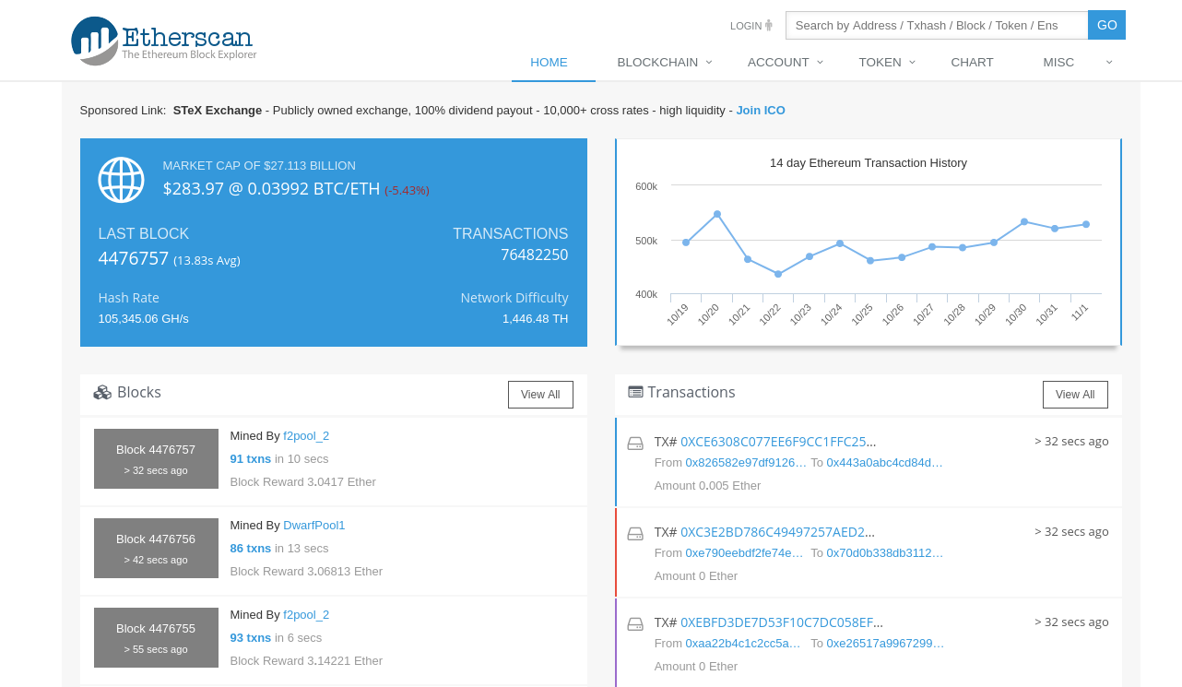
Etherscan.io

Slide 37
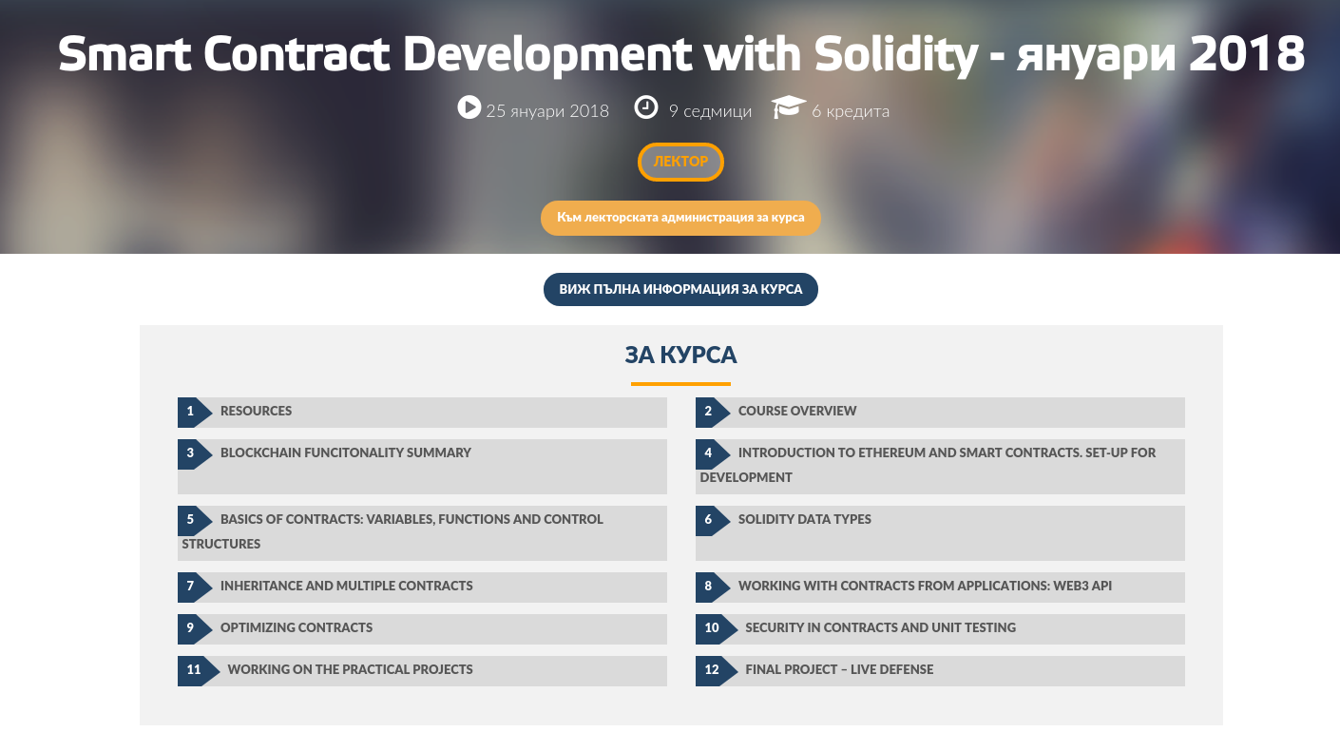
About the Solidity course

Slide 38
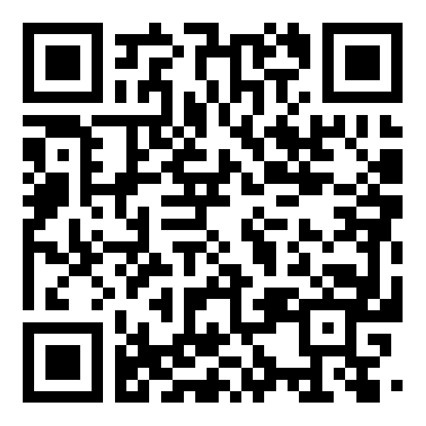
zvezdin@obecto.com

Slide 39
--------------------------

Slide 40
ideas
the dao fail
parity hack
forks
recent news
eth classic

Slide 41
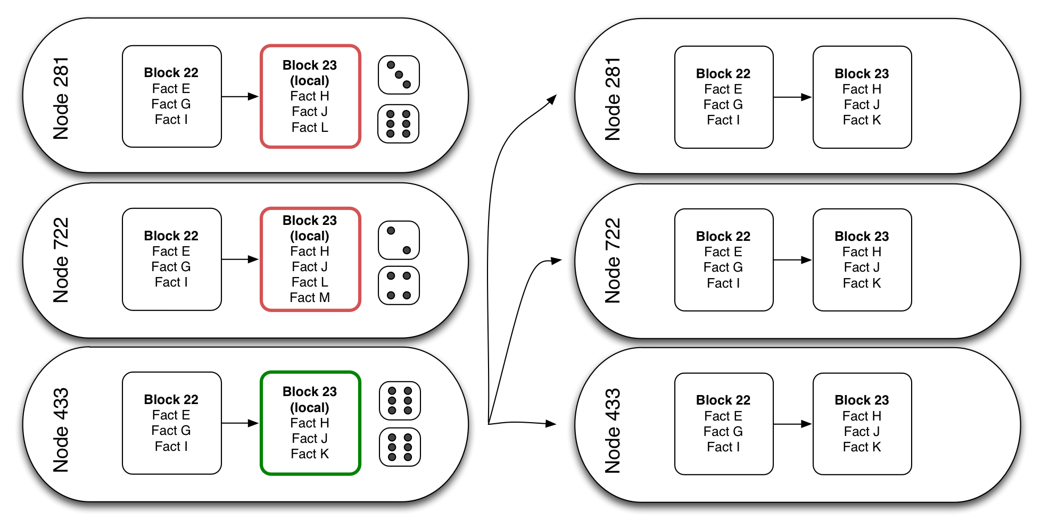
Notes:
Майнинг процесът

Slide 42
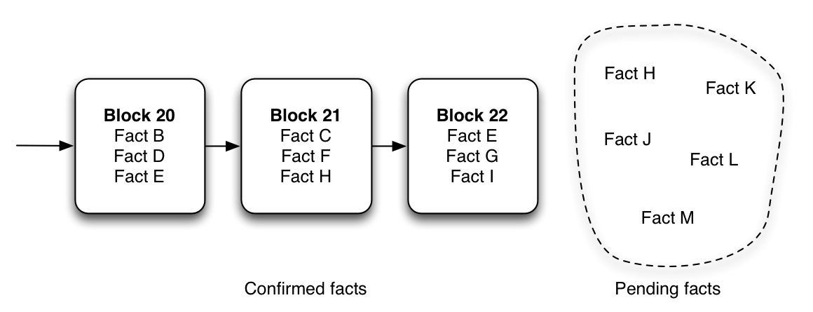
Notes:
Поради сигурността и децентрализацията, всичко вече в блокчейна е факт и закон.

